Slide 1
If Ye Do These Things
Salem Bible Students Convention
June 26, 2020

Slide 2
Wherefore the rather, brethren, give diligence to make your calling and election sure: for if ye do these things, ye shall never fall:
2 Peter 1:10 KJV

Slide 3
There is no standstill for the New Creature. He must go on and reach a certain standard of perfection, else he cannot be counted in as one of the Kingdom class. The Apostle does indeed speak of the New Creatures as at first being babes in Christ, but the Kingdom will not be made up of babes in Christ, but of overcomers, and the overcoming is not, as we know, a matter of age or physical stature, but a matter of spiritual development, of growth in grace and knowledge and love. We are to grow in love, and love is the principle thing, but before we can make much development in the cultivation of love, we must learn to be just, right, righteous. It is a proper presentation of the matter that is given in the proverb, that a man should be just before he is generous. (R3323.1)

Slide 4
Wherefore the rather, brethren, give diligence to make your calling and election sure: for if ye do these things, ye shall never fall:
2 Peter 1:10 KJV

Slide 5
For even hereunto were ye called: because Christ also suffered for us, leaving us an example, that ye should follow his steps:
1 Peter 2:21 KJV

Slide 6
For even hereunto were ye called: because Christ also suffered for us, leaving us an example, that ye should follow his steps:
1 Peter 2:21 KJV
For whom he did foreknow, he also did predestinate to be conformed to the image of his Son, that he might be the firstborn among many brethren.
Romans 8:29 KJV

Slide 7
For many are called, but few are chosen.
Matthew 22:14 KJV

Slide 8
For many are called, but few are chosen.
Matthew 22:14 KJV
Because strait is the gate, and narrow is the way, which leadeth unto life, and few there be that find it.
Matthew 7:14 KJV

Slide 9
For ye see your calling, brethren, how that not many wise men after the flesh, not many mighty, not many noble, are called:
1 Corinthians 1:26 KJV

Slide 10
For ye see your calling, brethren, how that not many wise men after the flesh, not many mighty, not many noble, are called:
1 Corinthians 1:26 KJV
Not every one that saith unto me, Lord, Lord, shall enter into the kingdom of heaven; but he that doeth the will of my Father which is in heaven.
Matthew 7:21 KJV

Slide 11
And be not conformed to this world: but be ye transformed by the renewing of your mind, that ye may prove what is that good, and acceptable, and perfect, will of God.
Romans 12:2 KJV

Slide 12
And be not conformed to this world: but be ye transformed by the renewing of your mind, that ye may prove what is that good, and acceptable, and perfect, will of God.
Romans 12:2 KJV
And beside this, giving all diligence, add to your faith virtue; and to virtue knowledge; And to knowledge temperance; and to temperance patience; and to patience godliness; And to godliness brotherly kindness; and to brotherly kindness charity.
2 Peter 1:5-7 KJV

Slide 13
And be not conformed to this world: but be ye transformed by the renewing of your mind, that ye may prove what is that good, and acceptable, and perfect, will of God.
Romans 12:2 KJV

Slide 14
And be not conformed to this world: but be ye transformed by the renewing of your mind, that ye may prove what is that good, and acceptable, and perfect, will of God.
Romans 12:2 KJV
As obedient children, not fashioning yourselves according to the former lusts in your ignorance:
1 Peter 1:14 KJV

Slide 15
I can of mine own self do nothing: as I hear, I judge: and my judgment is just; because I seek not mine own will, but the will of the Father which hath sent me.
John 5:30 KJV

Slide 16
Wherefore the rather, brethren, give diligence to make your calling and election sure: for if ye do these things, ye shall never fall:
2 Peter 1:10 KJV

Slide 17
Wherefore the rather, brethren, give diligence to make your calling and election sure: for if ye do these things, ye shall never fall:
2 Peter 1:10 KJV
And beside this, giving all diligence, add to your faith virtue; and to virtue knowledge;
2 Peter 1:5 KJV

Slide 18
But without faith it is impossible to please him: for he that cometh to God must believe that he is, and that he is a rewarder of them that diligently seek him.
Hebrews 11:6 KJV

Slide 19
But without faith it is impossible to please him: for he that cometh to God must believe that he is, and that he is a rewarder of them that diligently seek him.
Hebrews 11:6 KJV
Now faith is the substance of things hoped for, the evidence of things not seen.
Hebrews 11:1 KJV

Slide 20
And beside this, giving all diligence,
  add to your faith virtue;
    and to virtue knowledge;
      and to knowledge temperance;
        and to temperance patience;
          and to patience godliness;
            and to godliness brotherly kindness;
              and to brotherly kindness charity.
2 Peter 1:5-7 KJV

Slide 21
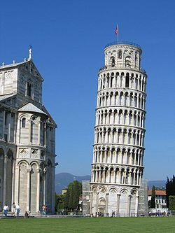
And beside this, giving all diligence, add to your faith virtue; and to virtue knowledge; And to knowledge temperance; and to temperance patience; and to patience godliness; And to godliness brotherly kindness; and to brotherly kindness charity.
2 Peter 1:5-7 KJV

Slide 22
And beside this, giving all diligence, add to your faith virtue; and to virtue knowledge; And to knowledge temperance; and to temperance patience; and to patience godliness; And to godliness brotherly kindness; and to brotherly kindness charity.
2 Peter 1:5-7 KJV

Slide 23
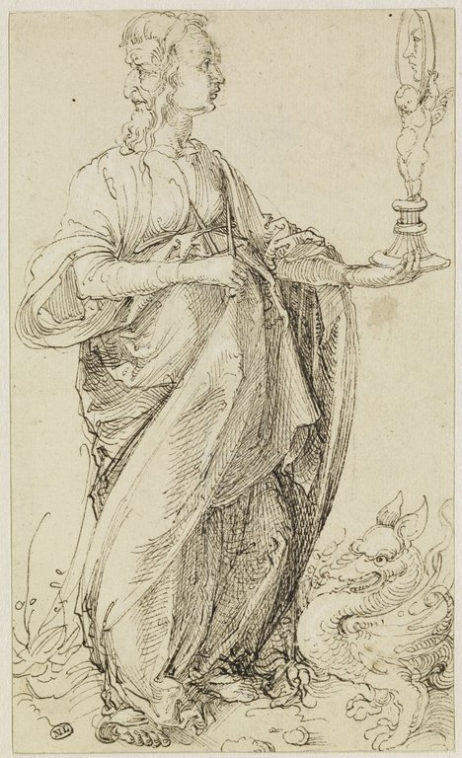
And beside this, giving all diligence, add to your faith virtue; and to virtue knowledge; And to knowledge temperance; and to temperance patience; and to patience godliness; And to godliness brotherly kindness; and to brotherly kindness charity.
2 Peter 1:5-7 KJV
La Prudencia
Albrecht Dürer (1471 – 1528)

Slide 24
Strong’s G703, arête (ar-et'-ay). From the same as G730; properly manliness (valor), that is, excellence (intrinsic or attributed): - praise, virtue.
Thayer Definition of G703: (1) a virtuous course of thought, feeling and action. (1a) virtue, moral goodness. (2) any particular moral excellence, as modesty, purity.
La Prudencia
Albrecht Dürer (1471 – 1528)

Slide 25
… Am I endeavoring to lead a virtuous life? This, to the child of God, consecrated to be a living sacrifice, implies much more than merely abstaining from evil. It implies living truthfully, that is, true to his covenant, which to wilfully violate would be equivalent to swearing falsely. It is fortitude, strength of character in righteousness. It implies the cultivation of the strictest integrity in our dealings, both with God and with our fellowmen, scrupulous honesty, justice and truth being the only standards. (R4808.12)
La Prudencia
Albrecht Dürer (1471 – 1528)

Slide 26
LORD, who shall abide in thy tabernacle? who shall dwell in thy holy hill? He that walketh uprightly, and worketh righteousness, and speaketh the truth in his heart. He that backbiteth not with his tongue, nor doeth evil to his neighbour, nor taketh up a reproach against his neighbour. In whose eyes a vile person is contemned; but he honoureth them that fear the LORD. He that sweareth to his own hurt, and changeth not.
Psalms 15:1-4 KJV
La Prudencia
Albrecht Dürer (1471 – 1528)

Slide 27
The integrity of the upright shall guide them: but the perverseness of transgressors shall destroy them.
Proverbs 11:3 KJV
La Prudencia
Albrecht Dürer (1471 – 1528)

Slide 28
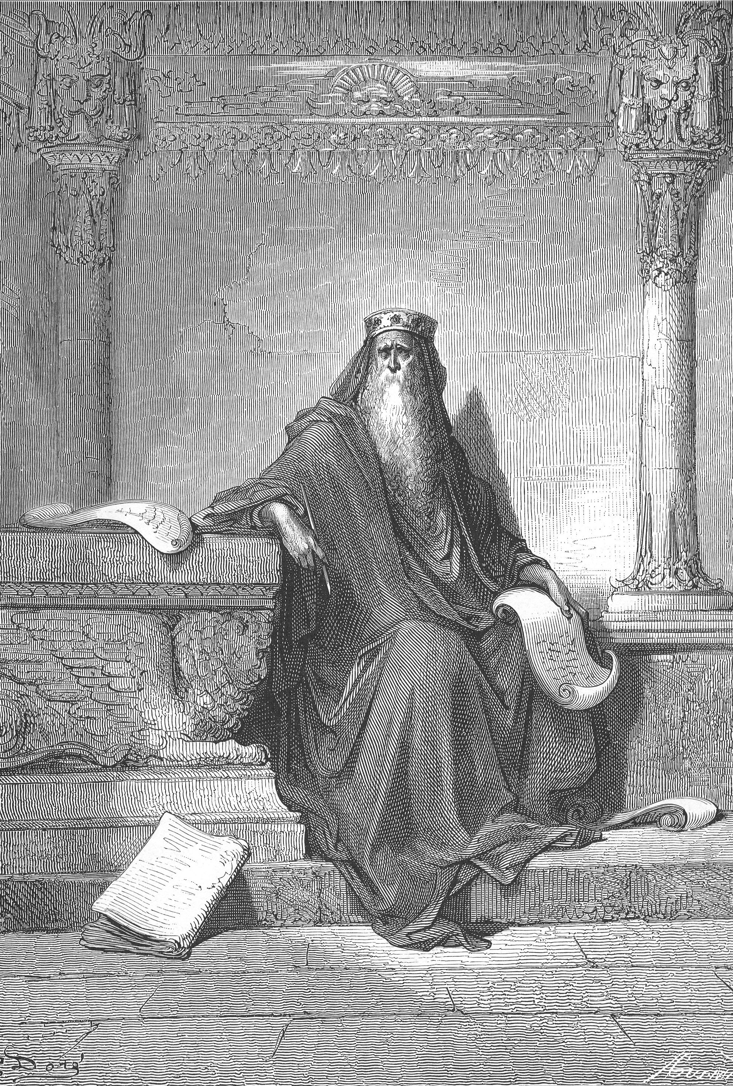
And beside this, giving all diligence, add to your faith virtue; and to virtue knowledge; And to knowledge temperance; and to temperance patience; and to patience godliness; And to godliness brotherly kindness; and to brotherly kindness charity.
2 Peter 1:5-7 KJV
Solomon Writing Proverbs
Gustave Doré (1832 – 1883)

Slide 29
And this is life eternal, that they might know thee the only true God, and Jesus Christ, whom thou hast sent.
John 17:3 KJV
Solomon Writing Proverbs
Gustave Doré (1832 – 1883)

Slide 30
Grace and peace be multiplied unto you through the knowledge of God, and of Jesus our Lord,
2 Peter 1:2 KJV
Yea doubtless, and I count all things but loss for the excellency of the knowledge of Christ Jesus my Lord: for whom I have suffered the loss of all things, and do count them but dung, that I may win Christ,
Philippians 3:8 KJV
Solomon Writing Proverbs
Gustave Doré (1832 – 1883)

Slide 31
But to God be the thanks who in Christ ever heads our triumphal procession, and by our hands waves in every place that sweet incense, the knowledge of Him.
2 Corinthians 2:14 Weymouth
Solomon Writing Proverbs
Gustave Doré (1832 – 1883)

Slide 32
It is a serious error into which many fall, to suppose that a knowledge of God's doings and plans is of little importance—that the graces of Christian character are all that God requires … How differently the Scriptures present the matter! … (B28.2)
Solomon Writing Proverbs
Gustave Doré (1832 – 1883)

Slide 33
Now as touching things offered unto idols, we know that we all have knowledge. Knowledge puffeth up, but charity edifieth.
1 Corinthians 8:1 KJV
Solomon Writing Proverbs
Gustave Doré (1832 – 1883)

Slide 34
But grow in grace, and in the knowledge of our Lord and Saviour Jesus Christ. To him be glory both now and for ever. Amen.
2 Peter 3:18 KJV
Solomon Writing Proverbs
Gustave Doré (1832 – 1883)

Slide 35
Casting down imaginations, and every high thing that exalteth itself against the knowledge of God, and bringing into captivity every thought to the obedience of Christ;
2 Corinthians 10:5 KJV
Solomon Writing Proverbs
Gustave Doré (1832 – 1883)

Slide 36
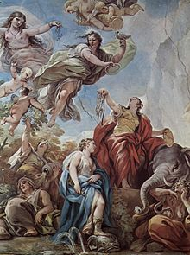
And beside this, giving all diligence, add to your faith virtue; and to virtue knowledge; And to knowledge temperance; and to temperance patience; and to patience godliness; And to godliness brotherly kindness; and to brotherly kindness charity.
2 Peter 1:5-7 KJV
Temperantia
Luca Giordano (1634 – 1705)

Slide 37
Let your moderation be known unto all men. The Lord is at hand.
Philippians 4:5 KJV
Temperantia
Luca Giordano (1634 – 1705)

Slide 38
Temperance:
Strong’s G1466, egkrateia (eng-krat'-i-ah). From G1468; self-control (especially continence): - temperance.
Thayer Definition of G1466: (1) self-control (the virtue of one who masters his desires and passions, especially his sensual appetites)
Temperantia
Luca Giordano (1634 – 1705)

Slide 39
He that is slow to anger is better than the mighty; and he that ruleth his spirit than he that taketh a city.
Proverbs 16:32 KJV
Temperantia
Luca Giordano (1634 – 1705)

Slide 40
He that is slow to anger is better than the mighty; and he that ruleth his spirit than he that taketh a city.
Proverbs 16:32 KJV
He that hath no rule over his own spirit is like a city that is broken down, and without walls.
Proverbs 25:28 KJV
Temperantia
Luca Giordano (1634 – 1705)

Slide 41
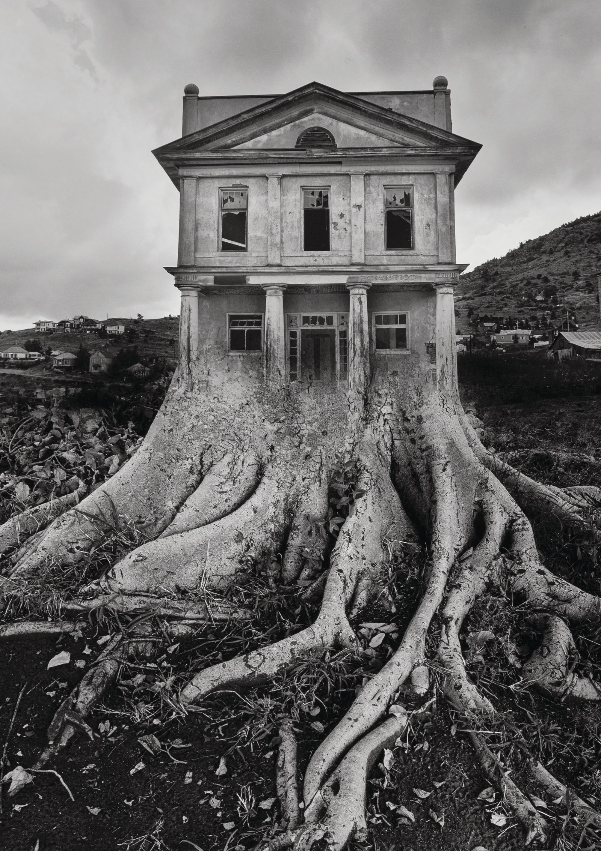
And beside this, giving all diligence, add to your faith virtue; and to virtue knowledge; And to knowledge temperance; and to temperance patience; and to patience godliness; And to godliness brotherly kindness; and to brotherly kindness charity.
2 Peter 1:5-7 KJV
Untitled
Jerry Uelsmann (1934 - )

Slide 42
But that on the good ground are they, which in an honest and good heart, having heard the word, keep it, and bring forth fruit with patience [Strong’s G5281, hupomonē] .
Luke 8:15 KJV
Untitled
Jerry Uelsmann (1934 - )

Slide 43
But that on the good ground are they, which in an honest and good heart, having heard the word, keep it, and bring forth fruit with patience [Strong’s G5281, hupomonē] .
Luke 8:15 KJV
In your patience [Strong’s G5281, hupomonē] possess ye your souls.
Luke 21:19 KJV
Untitled
Jerry Uelsmann (1934 - )

Slide 44
That ye be not slothful, but followers of them who through faith and patience inherit the promises.
Hebrews 6:12 KJV
Untitled
Jerry Uelsmann (1934 - )

Slide 45
That ye be not slothful, but followers of them who through faith and patience inherit the promises.
Hebrews 6:12 KJV
But let patience have her perfect work, that ye may be perfect and entire, wanting nothing.
James 1:4 KJV
Untitled
Jerry Uelsmann (1934 - )

Slide 46
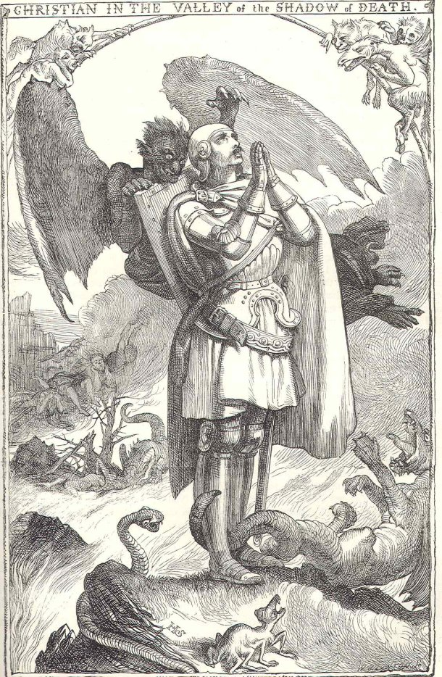
And beside this, giving all diligence, add to your faith virtue; and to virtue knowledge; And to knowledge temperance; and to temperance patience; and to patience godliness; And to godliness brotherly kindness; and to brotherly kindness charity.
2 Peter 1:5-7 KJV

Slide 47
But as he which hath called you is holy, so be ye holy in all manner of conversation; Because it is written, Be ye holy; for I am holy.
1 Peter 1:15-16 KJV

Slide 48
Seeing then that all these things shall be dissolved, what manner of persons ought ye to be in all holy conversation and godliness,
2 Peter 3:11 KJV

Slide 49
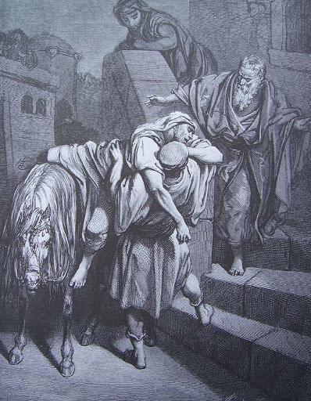
And beside this, giving all diligence, add to your faith virtue; and to virtue knowledge; And to knowledge temperance; and to temperance patience; and to patience godliness; And to godliness brotherly kindness; and to brotherly kindness charity.
2 Peter 1:5-7 KJV
The Good Samaritan Arrives at the Inn
Gustave Doré (1832 – 1883)

Slide 50
Be kindly affectioned one to another with brotherly love; in honour preferring one another;
Romans 12:10 KJV
The Good Samaritan Arrives at the Inn
Gustave Doré (1832 – 1883)

Slide 51
One of the final and most searching tests of these “brethren,” and the one under which probably the most of those once awakened and armed will fall, will be,—love for the brethren. Seemingly many will fail at this point and be therefore accounted unworthy of an abundant entrance to the Kingdom on this score. Whoever has the spirit of love according to the pattern (Rom. 8:29), is expected to agree with the Apostle Paul’s statement,— “Because he laid down his life for us, we ought also to lay down our lives for the brethren.”—1 John 3:14,16; 1 Peter 1:22; 3:8. (R2453.8)
The Good Samaritan Arrives at the Inn
Gustave Doré (1832 – 1883)

Slide 52
Seeing ye have purified your souls in obeying the truth through the Spirit unto unfeigned love of the brethren [Strong’s G5360, philadelphia], see that ye love [Strong’s G25, agapao] one another with a pure heart fervently:
1 Peter 1:22 KJV
The Good Samaritan Arrives at the Inn
Gustave Doré (1832 – 1883)

Slide 53
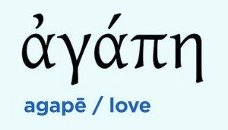
And beside this, giving all diligence, add to your faith virtue; and to virtue knowledge; And to knowledge temperance; and to temperance patience; and to patience godliness; And to godliness brotherly kindness; and to brotherly kindness charity.
2 Peter 1:5-7 KJV

Slide 54
But as touching brotherly love ye need not that I write unto you: for ye yourselves are taught of God to love [Strong’s G25, agapao] one another.
1 Thessalonians 4:9 KJV

Slide 55
Now the end of the commandment is charity [Strong’s G26, agape] out of a pure heart, and of a good conscience, and of faith unfeigned:
1 Timothy 1:5 KJV

Slide 56
A new commandment I give unto you, That ye love [Strong’s G26, agape] one another; as I have loved [Strong’s G26, agape] you, that ye also love [Strong’s G26, agape] one another.
John 13:34 KJV

Slide 57
It does not astonish us that the Lord directs that we love one another, but we stand amazed with the thought contained in these words, “As I have loved you.” How can we love one another with the same love which the Lord has for each of us? is our first inquiry. We reply that this is impossible at first, but as we become more and more filled with the Spirit of the Lord, we approximate more nearly to this standard of perfect love to all that are his, a love that not only would refuse to do injury to another, but a love which would delight to do good to a brother, … (R3547.3)

Slide 58
Hereby perceive we the love [Strong’s G26, agape] of God, because he laid down his life for us: and we ought to lay down our lives for the brethren.
1 John 3:16 KJV

Slide 59

For if these things be in you, and abound, they make you that ye shall neither be barren nor unfruitful in the knowledge of our Lord Jesus Christ.
2 Peter 1:8 KJV

Slide 60
If these things exist in you, and continually increase, they prevent your being either idle or unfruitful in advancing towards a full knowledge of our Lord Jesus Christ.
2 Peter 1:8 Weymouth

Slide 61
There is no standstill for the New Creature. He must go on and reach a certain standard of perfection, else he cannot be counted in as one of the Kingdom class. The Apostle does indeed speak of the New Creatures as at first being babes in Christ, but the Kingdom will not be made up of babes in Christ, but of overcomers, and the overcoming is not, as we know, a matter of age or physical stature, but a matter of spiritual development, of growth in grace and knowledge and love. We are to grow in love, and love is the principle thing, but before we can make much development in the cultivation of love, we must learn to be just, right, righteous. It is a proper presentation of the matter that is given in the proverb, that a man should be just before he is generous. (R3323.1)

